Slide 1
Pharmacy Management System
Submitted TO:
Department of cse
Submitted By:
Varinder Kumar (1414744)
Kajal (1510568)

Slide 2
Introduction
Pharmacy Management System is a web-based application implemented in PHP using MySQL as the database.
Pharmacy management system is a management system that is designed to improve accuracy and to enhance safety and efficiency in the pharmaceutical store.
The system will also give report showing the list of products expiry after a specified date before the product eventually expires.
It also involves manual entry upon arrival of new batches of drugs and upon drug movement out of the pharmacy for a certain period, e.g. every month, the pharmacist may want to generate report for the movement of drugs in and out of the pharmacy, getting information about the drugs e.g. expiry date, date purchased, number of drug type left, location of a drug in the pharmacy.

Slide 3
Existing System
The existing system is paper-based involving high amount of paper work and manpower requirement. Even though computerized systems are used in some places, they are also web-based system and are improperly managed. So, the current pharmacy management procedure is very uneconomical and inflexible to meet user demands.
But in our project we are enhancing some features of existing pharmacy system. This system includes the out-of-date stock or confirmation about out-stock medicine validation.

Slide 4
Proposed System:
The proposed system, being web-based, is very efficient and effective from the point of view of work productivity and time. It is less tedious to manage operations in a medical store or pharmacy with such a system. It has all the required modules and is developed with the aim of managing staffs, schedule, inventories, and relevant things in the medical store.
With this system, the entire operations in medical store is fully automated. Unlike the traditional system where records were maintained manually, this system maintains records in a database. Typical example of these records include purchases, counter sales, recorder levels, staffs, suppliers, customers, monetary transactions, etc.

Slide 5
Objectives
It is the user friendly application for Pharmacist which reduces the burden and helps to manage all sections of Pharmacy like Medicine management and Billing etc.
It deals with the automating tasks of maintaining of Bills.
In Pharmacy, Billing management is the key process. Including safe data store about medicine as well as fast searching, delete and update of medicines.
The pharmacy management system is easy for use so the user can do pharmacy actions without ambiguities.
This refers the pharmacy management system project highly minimize time and resource by which, searching the medicine data you can get the data in quickest time.
The pharmacy management system is built for the sake of ensuring effective and clear data saving and manipulating as well as neat work on the pharmacy medical products.
A summarized list of drugs dispensed to patient can be viewed for monitoring purposes. Also PMS will be able to generate report on the list of drugs dispensed in the polyclinic for a given time period.

Slide 6
Modules
Admin: Admin should have prior knowledge of the system. Admin is able to control the whole system. He/she can add, delete, update and modify the system.
Cashier: Pharmacy Cashiers handle customer transactions and operate the cash register in a pharmacy and give a bill to the customer .
Pharmacists: The pharmacist will be able to see the list of newly ordered drug prescriptions by the doctors for each patient. They will select the order which they want to dispense. The pharmacist can manually select the batch or the system will automatically get the batch as first-in, first-out process.
User: To buy medicines.

Slide 7
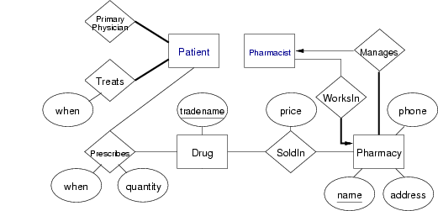
ER Diagram

Slide 8
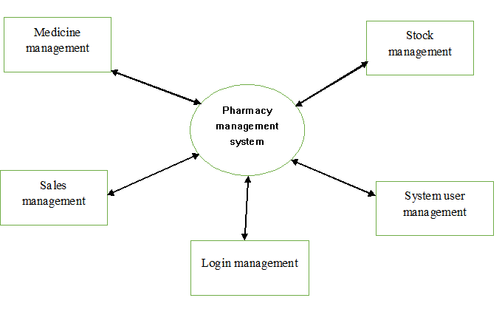
DFD:

Slide 9
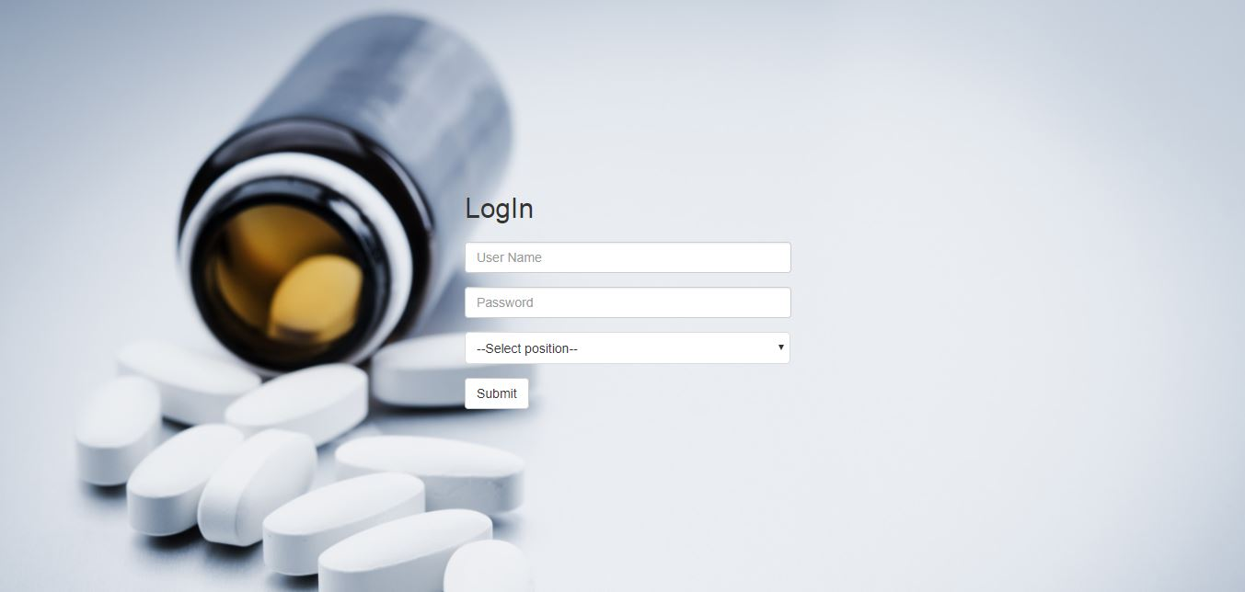
Screen Shots:

Slide 10
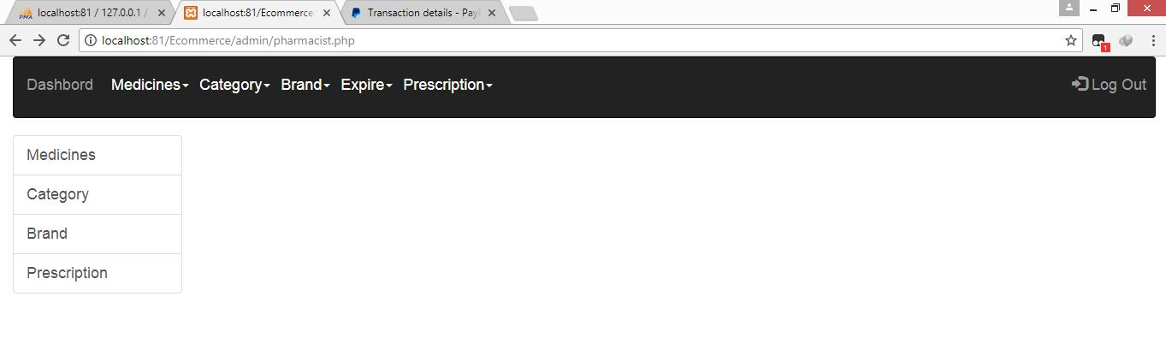

Slide 11
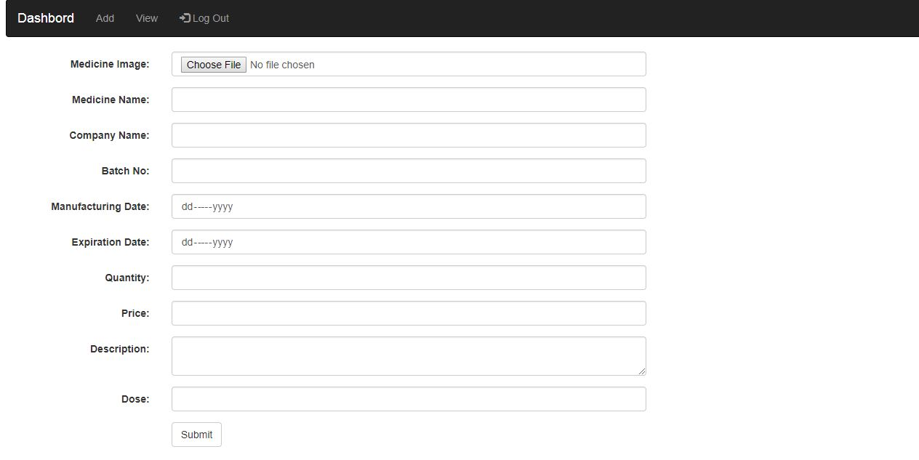

Slide 12
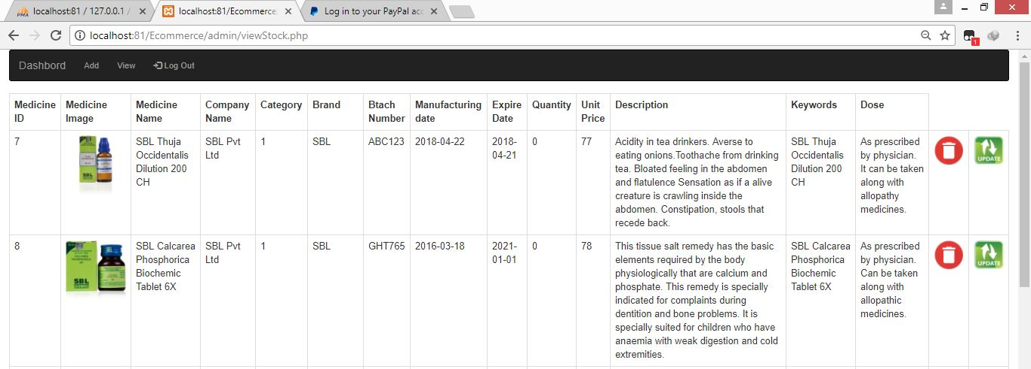

Slide 13
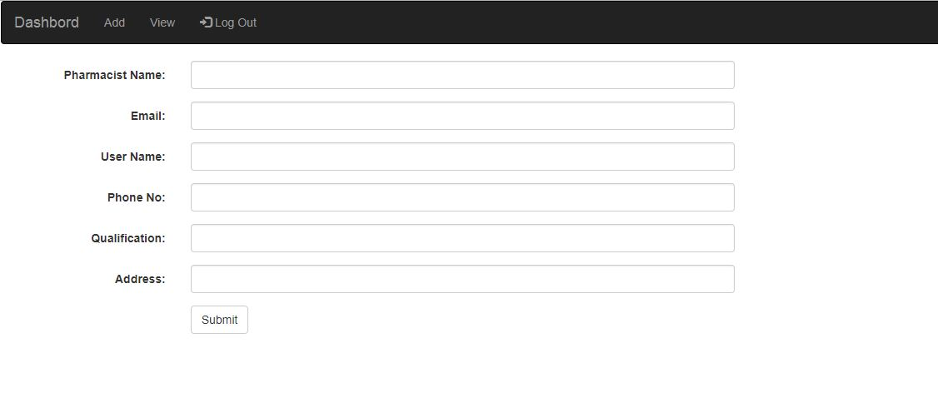

Slide 14
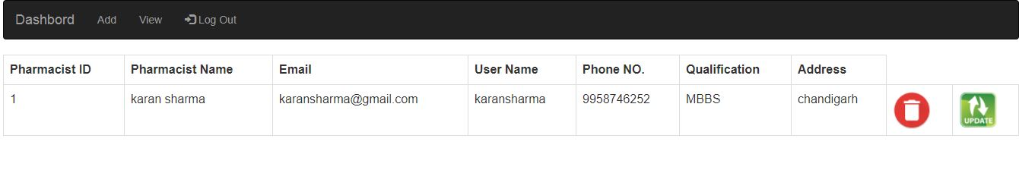

Slide 15
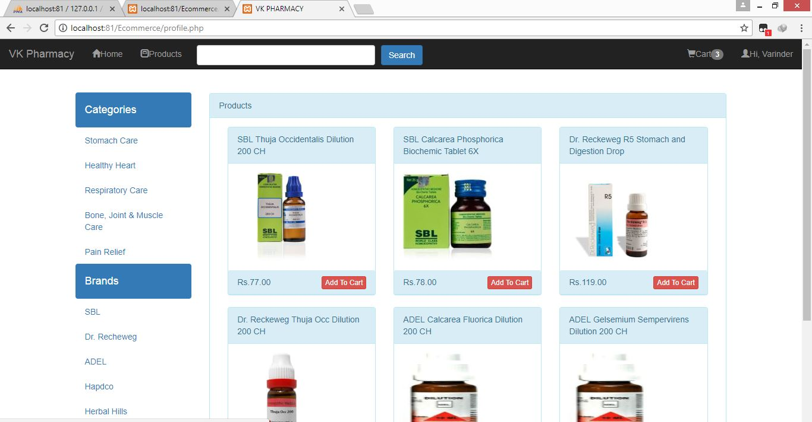

Slide 16
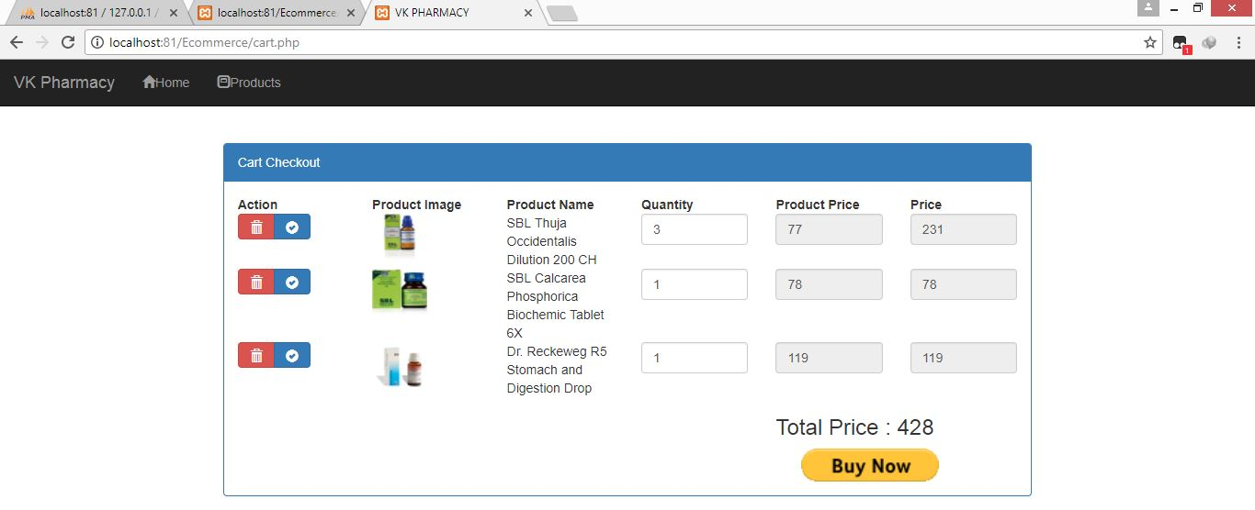

Slide 17
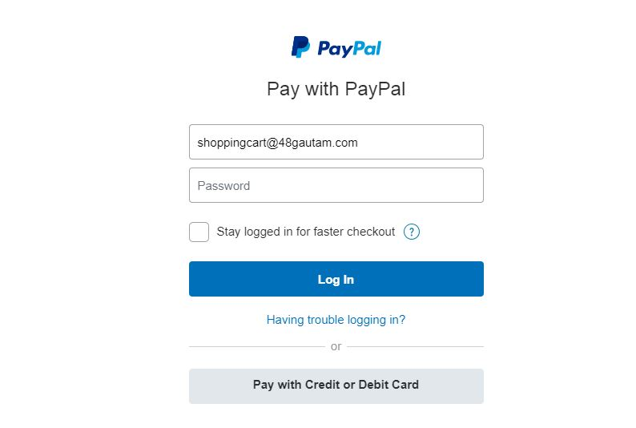

Slide 18
Technology and Tools used:
TECHNOLOGY
TOOLS
Front End:
HTML 5, CSS 3, JavaScript
JQuery
Bootstrap 4.0
PHP 7
Back End:
My SQL
Adobe Dreamweaver
Notepad++
XAMPP Server

Slide 19
Future Scope
Developing an application for android devices that works on the same database which is the mini of (MySQL).
The android application will be useful for controlling the system like remote app.
This project can be modified in future according to the organization need.
They can now purchase medicines by just a single click and from sitting at home wasting no time and energy.

Slide 20
Thank You

